Slide 1
GEOG0114: Principles of spatial analysis
WEEK 6: GEOSTATISTICAL MODELLING
Dr Anwar Musah (a.musah@ucl.ac.uk)
Lecturer in Social and Geographic Data Science
UCL Geography
1

Slide 2
Contents
What is Geostatistics?
Inverse Distance Weighting (IDW)
Kriging modelling
Variogram analysis (empirical and theoretical variogram)
Graphing the semivariogram
Estimation of various parameters (sill, nugget and range)
Types of Theoretical Variogram to be Mindful off…
Workflow for performing a Kriging
Problem
Knowledge
Collect
Model
Wrangle
Explore
2

Slide 3

QUICK recap
In week 5, we learn that ecological niche models are used on outcomes that are typically a point-process (i.e., events that occur at random e.g., wildfires, crime, road accidents etc.,).
Niche Models are used to predict where point-process outcomes are likely to occur based on a set of conditions, and where it is suitable for such outcome (i.e., presence-only, presence-absence or presence-pseudo absence data)
In week 3, we spoke of the various ways to represent geographic space through a device called a Spatial Weight Matrix. Computation of this device is needed in the estimation of spatial autocorrelation.
Let’s rewind a bit to last week,
And to the Week 3 and 5
3
Notes:
Before we start, let’s recap on last week

Slide 4
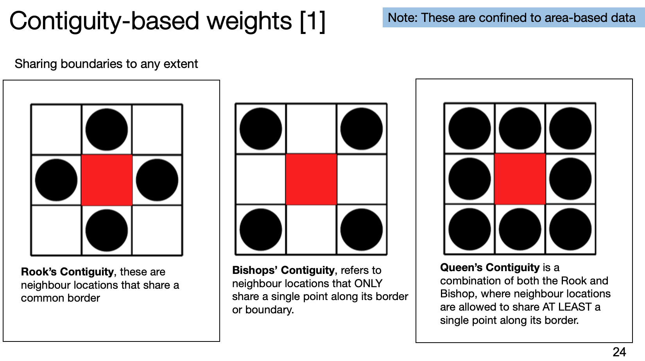
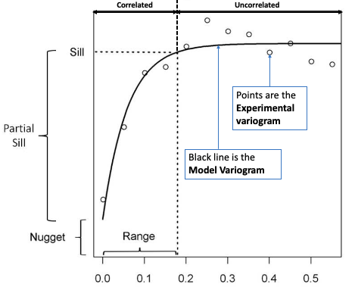
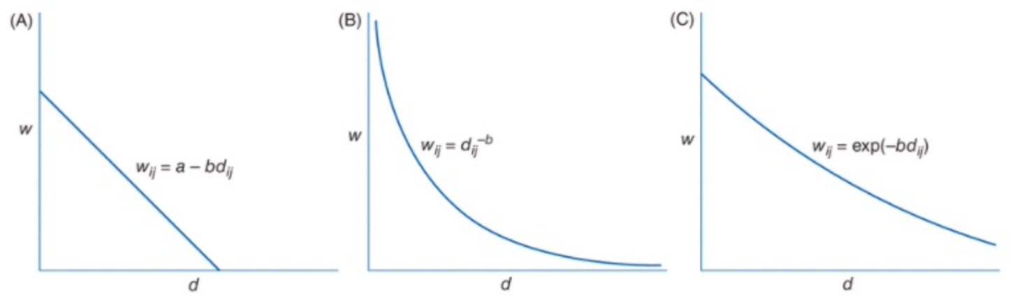
Area data – Contiguity-based weights
Point Geostatistical data – Distance-based weights
Distance Decay function
Inverse Distance Weighting
Semivariogram analysis
Kriging
4
Notes:
Contiguity-based (i.e., Queens, Rook & Bishop)
Distance-based (i.e., inverse, negative exponential)

Slide 5
Area data – Contiguity-based weights
Point Geostatistical data – Distance-based weights
Distance Decay function
Inverse Distance Weighting
Semivariogram analysis
Kriging
5

Slide 6
What is Geostatistics?
6

Slide 7
Definition of Geostatistics:
Geostatistics is class of spatial analytical methods used for predictive inference. They are a set of tools for predicting an outcome that is continuous. The prediction is made at unsampled locations which is based on a sample of fixed points (or neighbouring point observations).
The key focus and main ingredients for geostatistics are:
Fixed point locations (i.e., coordinates [longitude & latitude]) with a measured outcome (i.e., dependent variable) and other covariate data (i.e., independent variable(s))
Raster grid template for making the geospatial predictions
The procedure for predicting phenomena at a location that have not been sampled based on nearby sampled points is called “Spatial Interpolation”
7
Notes:
Give an example of a continuous outcome

Slide 8
In terms of geostatistical methodologies, there are two main branches of models:
In terms of similarity between IDW and Kriging – it weights the surrounding measured values to derive a prediction for an unmeasured location.
Differences are in the assumptions:
IDW assumes that spatial autocorrelation between neighboring points is proportional to the distance (and that it can be defined by distance reverse function). It is distance focused only.
Kriging assumes that distance (mainly) or directionality between sampling points reflects the spatial autocorrelation, and functions can be fitted to describe the correlation between points (and explain the variation on the surface)
 | Deterministic | Probabilistic
Definition(s) | These type of models have parameter values that are typically arbitrarily defined | The parameter values from this model must be estimated first before making a prediction about something
Model Types | Inverse Distance Weighting (IDW) | Kriging
Notes 1: Both rely on the similarity of nearby sample points to create or predict the surface, the deterministic relies purely on mathematical functions for interpolation, while statistical models are a combination of both statistics and mathematical methods to create the predicted surface and also produce levels of uncertainty about the predictions.
Notes 2: Kriging is a much better model, it is an approach that is more sophisticated than the IDW. Because of its deterministic nature, the prediction from IDWs tend to be less accurate (but with Kriging, a regression (either it be a null, or a simple or multivariable) model is calibrated into it.
8

Slide 9
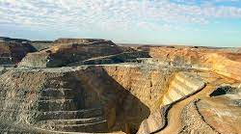
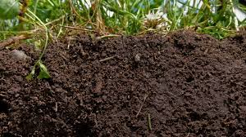


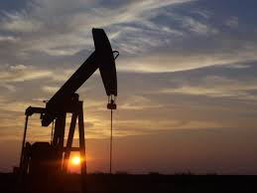
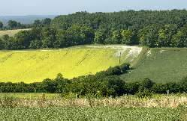

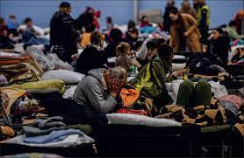
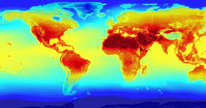
Mining
Soil science
Environmental Criminology
Environmental & Spatial Epidemiology
Oil & Gas excavation
Landscape ecology
Pollution Science
Climate
Humanitarian crisis
9

Slide 10
Inverse Distance Weighting (IDW)
10

Slide 11
Inverse Distance Weighting (IDW) [1]
Inverse Distance Weighting (IDW) is a deterministic approach which assumes that each input point has a local influence that diminishes with distance. It is a method of spatial interpolation that predicts a spatial location that is unsampled by using nearby sampled locations to apply distance-based weights and then averaging those sampled values.
The key characteristics of IDWs:
It heavily relies on some distance decay function which applies weights of greater value to sampled points closest to the “point of interest” (we want to predict) than sampled points that further away.
A specified number of points, or all points within a specified radius can be used to determine the output value of each location. Use of this method assumes the variable being mapped decreases in influence with distance from its sampled location.
11
Notes:
It is all about “borrowing” the strength of closer neighbouring points to an unsampled point location we want to predict and averaging those points to produce a prediction.

Slide 12

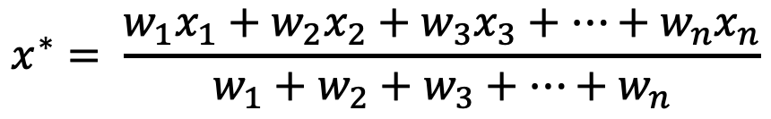
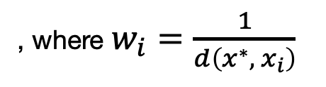
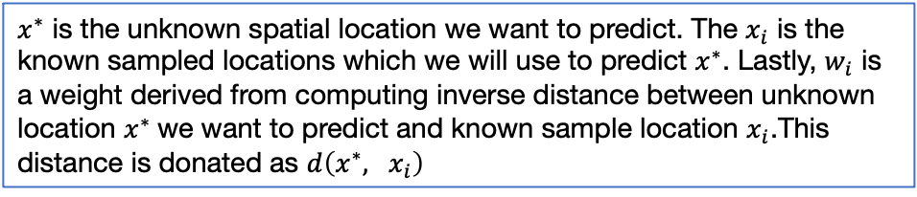

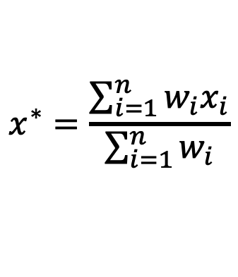
Inverse Distance Weighting (IDW) [2]
Inverse Distance Weighting (IDW) is a deterministic approach which assumes that each input point has a local influence that diminishes with distance. It is a method of spatial interpolation that predicts a spatial location that is unsampled by using nearby sampled locations to apply distance-based weights and then averaging those sampled values.
Mathematical formulation for IDW method:
$$x^{∗}= \frac{w_{1}x_{1}+w_{2}x_{2}+w_{3}x_{3}+…+w_{n}x_{n}}{w_{1}+w_{2}+w_{3}+…+w_{n}}$$
$$x^{∗}=\frac{\sum_{i=1}^{n}{w_{i}x_{i}}}{\sum_{i=1}^{n}{w_{i}}}$$
, where $w_{i}=\frac{1}{d\left(x^{∗}, x_{i}\right)}$
$$≡$$
[1]
Expanded form
Condensed form
$x^{∗}$ is the unknown spatial location we want to predict. The $x_{i}$ is the known sampled locations which we will use to predict $x^{∗}$. Lastly, $w_{i}$ is a weight derived from computing inverse distance between unknown location $x^{∗}$we want to predict and known sample location $x_{i}$.This distance is donated as $d\left(x^{∗}, x_{i}\right)$
$$≡$$
This symbol mean they are identical
12

Slide 13

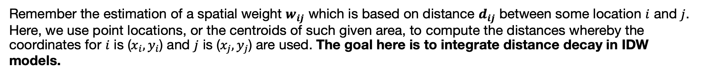
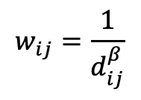
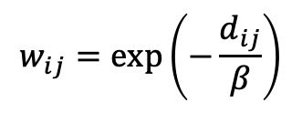
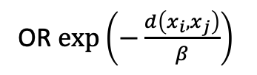
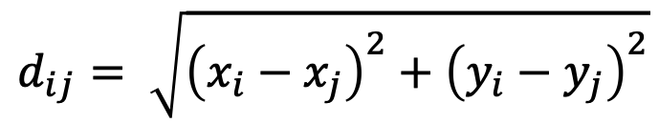

Distance and Spatial Weights [1]
Remember the estimation of a spatial weight $w_{ij}$ which is based on distance $d_{ij}$ between some location $i$ and $j$. Here, we use point locations, or the centroids of such given area, to compute the distances whereby the coordinates for $i$ is ($x_{i},y_{i}$) and $j$ is ($x_{j},y_{j}$) are used. The goal here is to integrate distance decay in IDW models.
Note $d_{ij}$ is the same as $d\left(x_{i}, x_{j}\right)$
$$d_{ij}= \sqrt{{\left(x_{i}−x_{j}\right)}^{2}+{\left(y_{i}−y_{j}\right)}^{2}}$$
[1]
Euclidean Distance:
Inverse Distance:
$$w_{ij}=\frac{1}{d_{ij}^{β}}$$
OR $\frac{1}{d\left(x_{i}, x_{j}\right)}$
[2]
$$w_{ij}=exp\left(−\frac{d_{ij}}{β}\right)$$
OR $exp\left(−\frac{d\left(x_{i}, x_{j}\right)}{β}\right)$
Negative exponential:
[3]
Note that $β$ = 1 or $β$ = 2 (we usually use 2, but it’s really up to you which ever value you pick!)
13
Notes:
Recall, this slide from week 3. We were taught how to derive these distance-based weights using the above formulation.
Distance/Separation distance

Slide 14
Distance and Spatial Weights [2]
Linear
Inverse
Negative exponential
For the IDWs, we usually select this method in computing our weights, which, in turn, are used in IDW model for spatial prediction
14
Notes:
Let us show you how this is implemented.

Slide 15
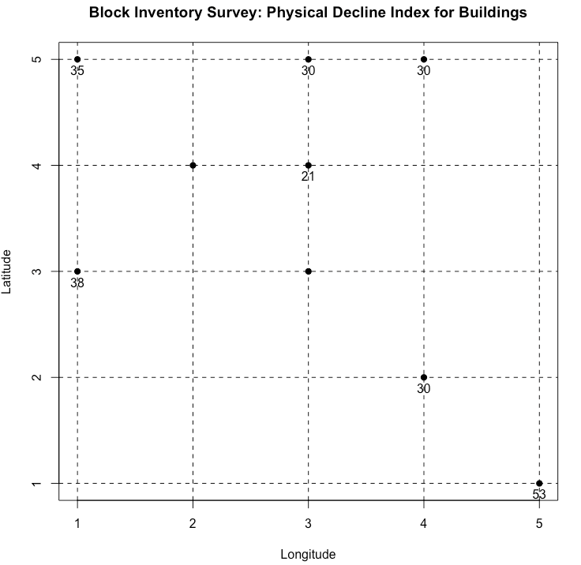
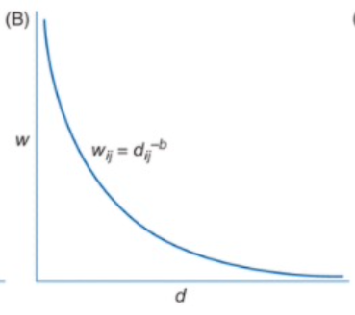
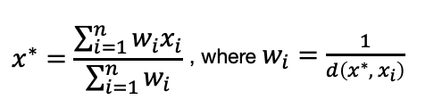

Example: Physical Decline Index of Buildings [1]
Here, we have a small study area with 7 sampled locations. A Block Inventory Survey (BIS) was carried out to measure the quality of buildings.
How do we use the IDW framework for predicting the two unsampled sites?
$$d= \sqrt{{\left(x_{0}^{∗}−x\right)}^{2}+{\left(y_{0}^{∗}−y\right)}^{2}}$$
[1]
[2]
[3]
Let us demonstrate this using the site with the red dashed circle. Let us represent this as $x^{∗}$. The points with the data are represented as $x_{i}$.
15
Notes:
It’s impossible to measure every single building (unless you have limitless funds to carry out such in-depth data collection). We have two points of interest we want to make the prediction for levels of Physical Decline.
We need to first compute all the distances that exist between the sampled and unsampled index location
Construct graph – compute for every value exist between between within the study’s region existent.

Slide 16

Example: Physical Decline Index of Buildings [2]
Step 1: We compute all the distance between each pair of points i.e., that is all sampled sites and unsampled site. We use the Euclidean distance formula for the calculation.
$$d= \sqrt{{\left(x_{0}^{∗}−x\right)}^{2}+{\left(y_{0}^{∗}−y\right)}^{2}}$$
16
Notes:
We need to first compute all the distances that exist between the sampled and unsampled index location

Slide 17


Example: Physical Decline Index of Buildings [3]
Step 1: We compute all the distance between each pair of points i.e., that is all sampled sites and unsampled site. We use the Euclidean distance formula for the calculation.
1.414214
1.414214
2.236068
1.0000
$$d= \sqrt{{\left(x_{0}^{∗}−x\right)}^{2}+{\left(y_{0}^{∗}−y\right)}^{2}}$$
1.414214
Step 2: We compute the weights using the inverse distance formula
2.828427
Lowest for d = 1.0
Highest for d = 4.2426
4.242641
We can create this graph by using the inverse distance formula for all values of d between 1 to 5
17

Slide 18
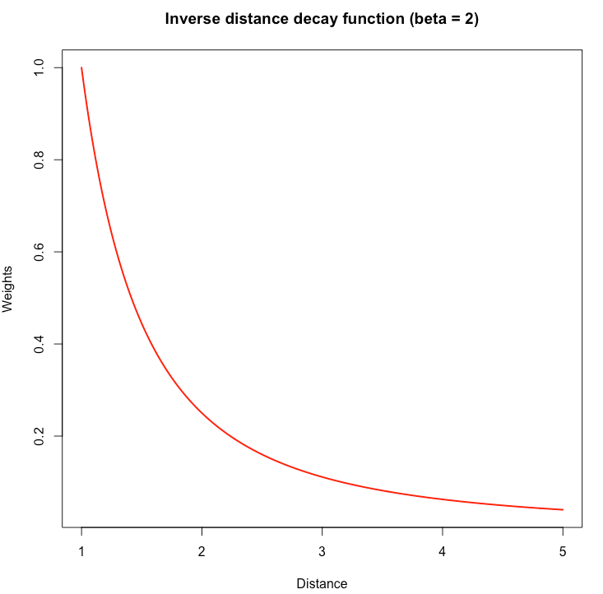
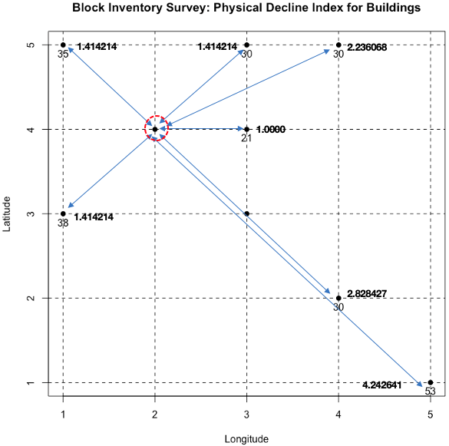
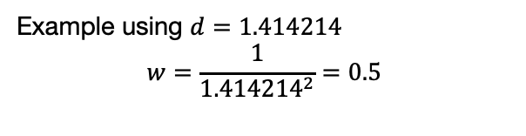

How to compute the distance-based weights
(w = 0.5000)
(w = 0.5000)
(w = 0.2000)
$$β$$
(w = 1.0000)
Example using $d=1.414214$
$$w=\frac{1}{{1.414214}^{2}}=0.5$$
(w = 0.5000)
(w = 0.1250)
(w = 0.0556)
1.414214
2.236068
2.8284…
4.242641
For each value of d along the x-axis, you trace to its corresponding
value on the y-axis to know its weight value.
18

Slide 19
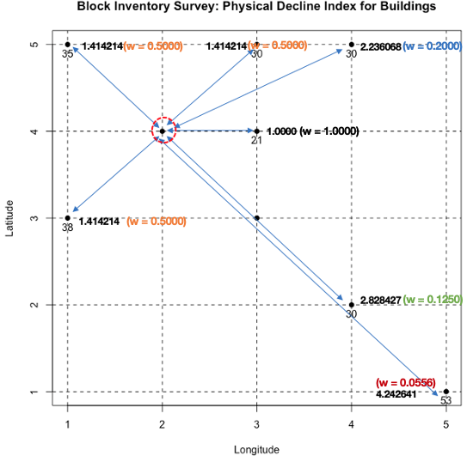
Example: Physical Decline Index of Buildings [4]
Step 1: We compute all the distance between each pair of points i.e., that is all sampled sites and unsampled site. We use the Euclidean distance formula for the calculation.
$$d= \sqrt{{\left(x_{0}^{∗}−x\right)}^{2}+{\left(y_{0}^{∗}−y\right)}^{2}}$$
Step 2: We compute the weights using the inverse distance formula
We can create this graph by using the inverse distance formula for all values of d between 1 to 5
19

Slide 20
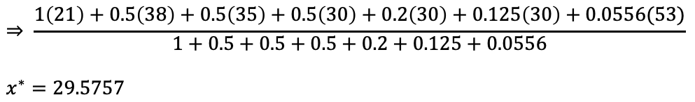


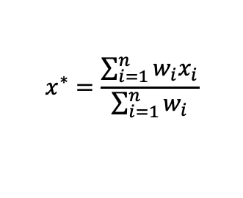
Example: Physical Decline Index of Buildings [5]
Step 3: Estimate $x^{∗}$ using that mathematical formula
$$x^{∗}=\frac{\sum_{i=1}^{n}{w_{i}x_{i}}}{\sum_{i=1}^{n}{w_{i}}}$$
$$≡$$
$$\frac{w_{1}x_{1}+w_{2}x_{2}+w_{3}x_{3}+…+w_{n}x_{n}}{w_{1}+w_{2}+w_{3}+…+w_{n}}$$
We multiple calculated weights with the observed values for Physical Decline Index, which in turn are summed. Next, we divide the numerator by the summed weights in the denominator to derive our interpolated point.
$$⇒ \frac{1\left(21\right)+0.5\left(38\right)+0.5\left(35\right)+0.5\left(30\right)+0.2\left(30\right)+0.125\left(30\right)+0.0556(53)}{1+0.5+0.5+0.5+0.2+0.125+0.0556}$$
$$x^{∗}=29.5757$$
The estimate PDI is 29.5757, this calculation is repeated for the other unsampled point etc.
Important Note: You can also specify some threshold distance to make the prediction on some K-number of nearest neighbours. Instead of using the full available sample of points
20

Slide 21
Example: Physical Decline Index of Buildings [6]
Here, we derived the value of 29.57 for the first unsampled point using the three-step framework below.
Use the steps again and repeat the process for the second point.
29.57
$$d= \sqrt{{\left(x_{0}^{∗}−x\right)}^{2}+{\left(y_{0}^{∗}−y\right)}^{2}}$$
[1]
[2]
[3]
We estimated PDI at the site with the red dashed circle. What about the second point in blue dashed circle? It is simply a case of repeating the steps again.
21
Notes:
It’s impossible to measure every single building (unless you have limitless funds to carry out such in-depth data collection). We have two points of interest we want to make the prediction for levels of Physical Decline.
We need to first compute all the distances that exist between the sampled and unsampled index location
Construct graph – compute for every value exist between between within the study’s region existent.

Slide 22
Kriging Modelling
22

Slide 23
What are Kriging Models [1]
Kriging is a statistical (or probabilistic) modelling approach which is capable of accounting distance, directionality, as well as the influence of external variables on the main outcome of interest for making predictions at unsampled locations.
The key characteristics of Kriging models:
Unlike the IDW which is purely based on distance decay between points. The kriging is more interested in both the separation distance between points as well as how these two points are spatial correlated with each other
Another important thing with Kriging, we can determine the threshold, at which the separation distance (or lag) where the points no longer spatially autocorrelated with each other using a graphical device called the semivariogram
It is through the semivariogram we can derive some important estimates called the Semivariance, Nugget, Sill (or Partial Sill) and Range to calibrate our Kriging model for spatial prediction.
Common types of Kriging models are: Ordinary Kriging, Regression-based Kriging, Universal Kriging, and
many more
23

Slide 24
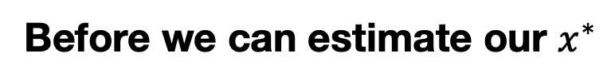
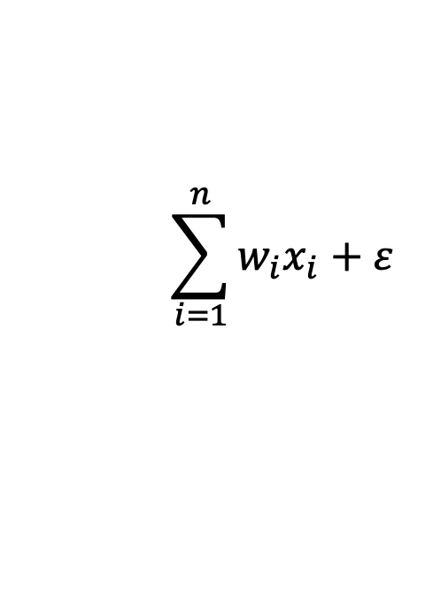

What are Kriging Models [2]
Kriging is a statistical (or probabilistic) modelling approach which is capable of accounting distance, directionality, as well as the influence of external variables on the main outcome of interest for making predictions at unsampled locations.
Mathematical formulation for the Kriging method:
$$\sum_{i=1}^{n}{w_{i}x_{i}+ε}$$
$$x^{∗}=w_{1}x_{1}+w_{2}x_{2}+w_{3}x_{3}+…+w_{n}x_{n}+ ε$$
$$≡$$
However, the computation of these weights are an involved process
Before we can estimate our $x^{∗}$
Calculate experimental variogram
Fit theoretical variogram model
Calculate weights (using the Lagrange multiplier method [numerical approximation technique] to the above equation to get the weights)
Prediction using Kriging equation above (you can obtain the predicted value and uncertainty [i.e., error])
[to obtain the parameters for the sill (or partial sill), nugget and Range, and visual shape of variogram]
[use the parameters obtained in (1) to build our theoretical variogram]
[we will combine the result from (1) and (2) in the estimation of weights]
[we will implement the weights in to the above equation to predict the thing at the unsampled location]
24
Notes:
I am showing you folks what’s happening underneath that car’s hood.

Slide 25
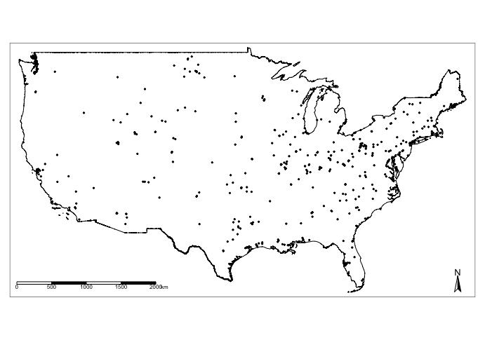
Example: Air pollution of Sulphur Dioxide (SO₂) in USA
Here, we have annual measures for SO₂ (Sulphur Dioxide) drawn from 458 pollution monitoring stations across USA. We want to estimate the SO₂ concentrations where the stations are not present.
How do we use the Kriging framework for predicting at the unsampled sites?
Estimation of the empirical variogram to obtain sill,
Partial, sill, range and nugget
[1]
From [1], specify our theoretical variogram in order to construct a covariance matrix
[2]
From [2], apply matrix algebra to estimate the weights
[3]
The points are air pollution monitoring stations which contain some measures for various air contaminants. We can use the Kriging models to predict the contamination levels where there are no stations (i.e., white spaces).
From [3], use result for weights and insert into our Kriging model to make our predictions
[4]
$$x^{∗}=w_{1}x_{1}+w_{2}x_{2}+w_{3}x_{3}+…+w_{n}x_{n}+ ε$$
25

Slide 26
What is a Variogram?
A variogram (or semivariogram) is a graphical output which allows the user to measure & plot the degree of how values differ according to how far apart they in space.
In any kriging analysis, quantifying the semivariogram is the most important step.
In order, to quantify those weights to make the prediction, there are four important quantities with must derive the following:
Semivariance
Sill (and Partial Sill)
Nugget
Range
26
Notes:
Variogram is a graphical output that shows the degree of how values differ in terms how they are spatially autocorrelated in relation to their separation distance.
If you are using kriging and you do not show this particular output in a research paper, or in your assignment – it will be an automatic critical error.

Slide 27

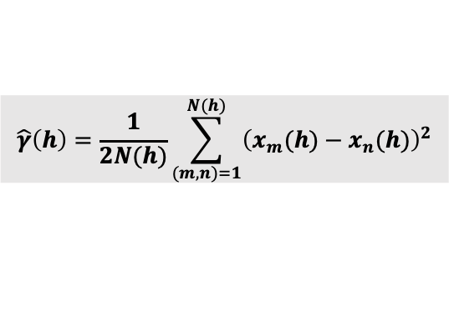

$$\hat{γ}\left(h\right)=\frac{1}{2N(h)}\sum_{(m,n)=1}^{N(h)}{{\left(x_{m}(h)−x_{n}(h)\right)}^{2}}$$
Definitions:
Sill: This is the maximum Semivariance value observed, and it shows the threshold (or flatline) for which points are no longer spatially autocorrelated.
Range: Maximum separation distance for h, at which we expect our paired points to no longer be spatially autocorrelated with each other.
Nugget: Is a measurement error. The larger the nugget relative to the sill, the less spatial dependence there is in the data and less useful Kriging will be.
Partial Sill: Is the difference between Sill and Nugget.
We will need to extract these values to determine the best “Theoretical Semivariogram”
$$γ\left(h\right)$$
$$h$$
Experimental (or Empirical) Semivariogram
x-axis (h) is the separation distance
y-axis y(h) is the Semivariance
27

Slide 28
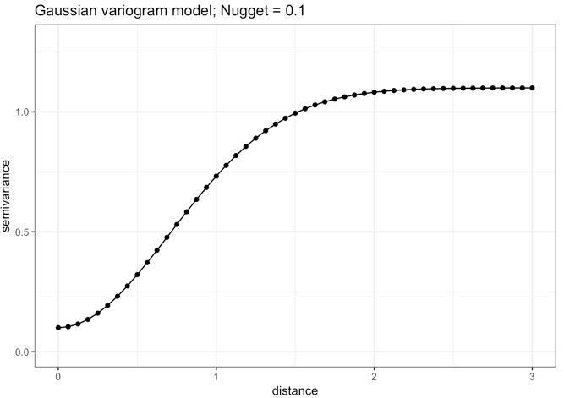
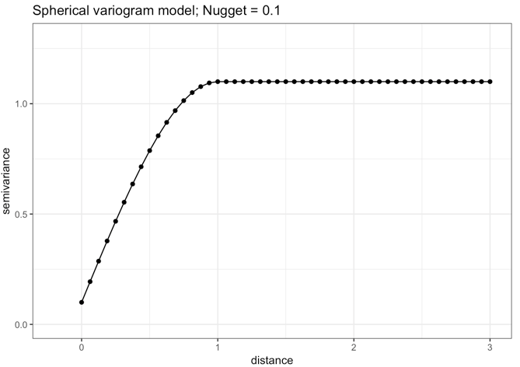
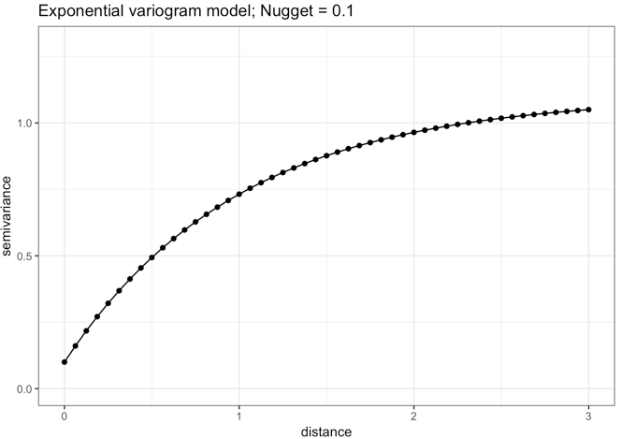
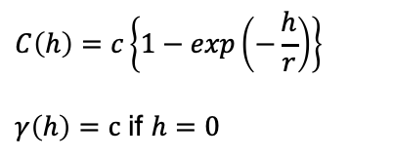
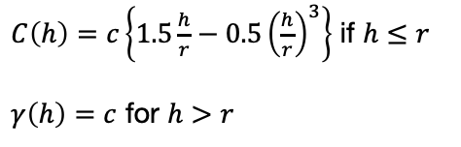


Common types of Theoretical Variograms
Gaussian:
$$C\left(h\right)=c\left\{1−exp\left(\frac{h^{2}}{r^{2}}\right)\right\}$$
Spherical:
$C\left(h\right)=c\left\{1.5\frac{h}{r}−0.5{\left(\frac{h}{r}\right)}^{3}\right\}$ if $h≤r$
$γ\left(h\right)=c$ for $h>r$
Exponential:
$$C\left(h\right)=c\left\{1−exp\left(−\frac{h}{r}\right)\right\}$$
$γ\left(h\right)=c$ if $h=0$
Note that $c=$ partial sill, $h=$separation distance and $r=$range. $C\left(h\right)$ is the covariance
Fitted Semivariance: $\overset{⃛}{ γ}\left(h\right)=c −C\left(h\right)$
28
Notes:
Covariance in this case refers to how the pair of points are spatial correlated with each other at a given separation distance (or lag).

Slide 29
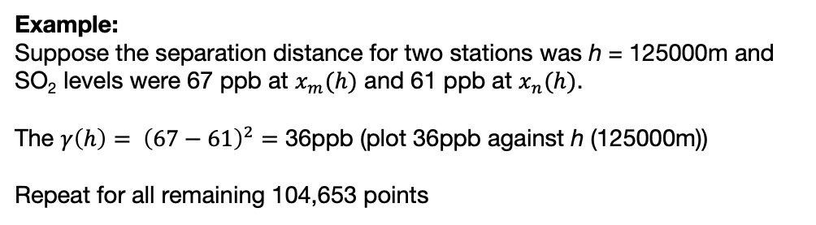

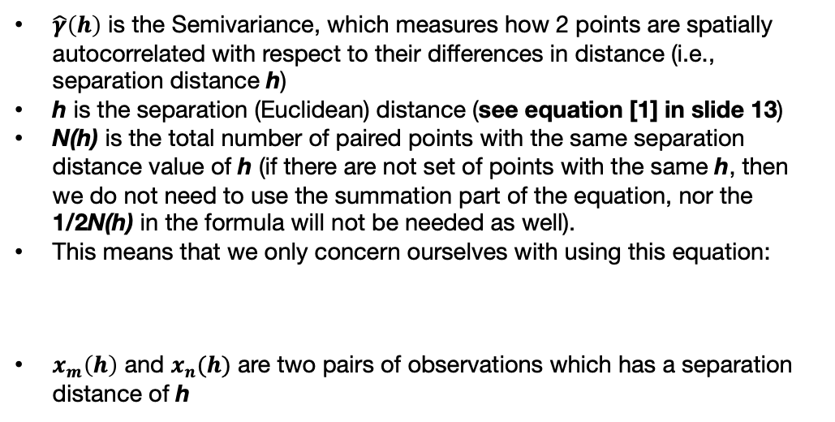
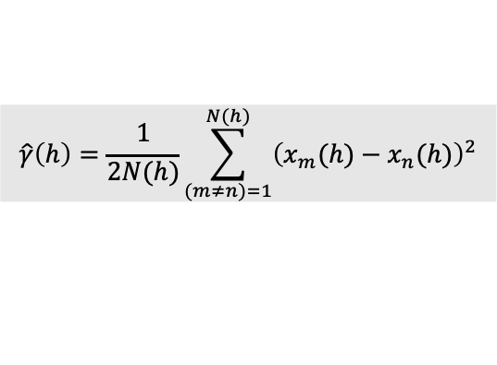
Step 1: Variogram analysis [1]
We need to use this formula to compute Semivariance from each pair of points that has values (i.e., pollution monitors)
$$\hat{γ}\left(h\right)=\frac{1}{2N(h)}\sum_{(m≠n)=1}^{N(h)}{{\left(x_{m}(h)−x_{n}(h)\right)}^{2}}$$
[1]
$\hat{γ}\left(h\right)$ is the Semivariance, which measures how 2 points are spatially autocorrelated with respect to their differences in distance (i.e., separation distance h)
h is the separation (Euclidean) distance (see equation [1] in slide 13)
N(h) is the total number of paired points with the same separation distance value of h (if there are not set of points with the same h, then we do not need to use the summation part of the equation, nor the 1/2N(h) in the formula will not be needed as well).
This means that we only concern ourselves with using this equation:
$x_{m}\left(h\right)$ and $x_{n}(h)$ are two pairs of observations which has a separation distance of h
The 458 points are air pollution monitoring stations which contain some measures for various air contaminants. We can use the Kriging model to predict the contamination levels where there are no stations (i.e., white spaces).
Red point is a location without a pollution monitor. Here, is an example of location where we can use the Kriging. [Hold this thought, we will come back to this in slide number 30)
$$\hat{γ}\left(h\right)={\left(x_{m}(h)−x_{n}(h)\right)}^{2}$$
[2]
We need to list every possible pair of points. So, from the 458 sample locations, there are 104,653 pairs. A distance between each point is calculated – this known as a separation distance (h). We will have a distribution of values on separation distance.
At the red point, a separation distance is computed elsewhere. Note that this place has no value, but we want to make a prediction at the point.
Example:
Suppose the separation distance for two stations was h = 125000m and SO₂ levels were 67 ppb at $x_{m}(h)$ and 61 ppb at $x_{n}(h)$.
The $γ\left(h\right)$ $= {\left(67−61\right)}^{2}=$ 36ppb (plot 36ppb against h (125000m))
Repeat for all remaining 104,653 points
29

Slide 30
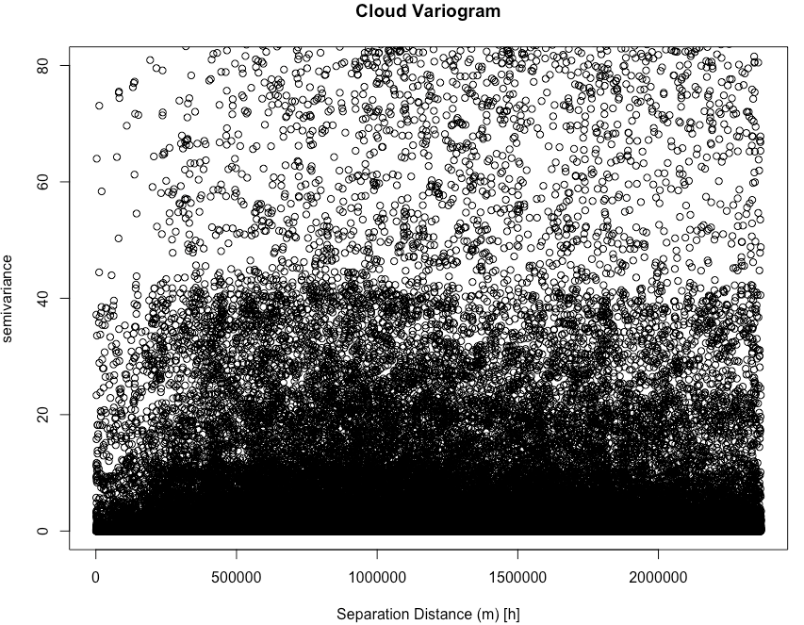
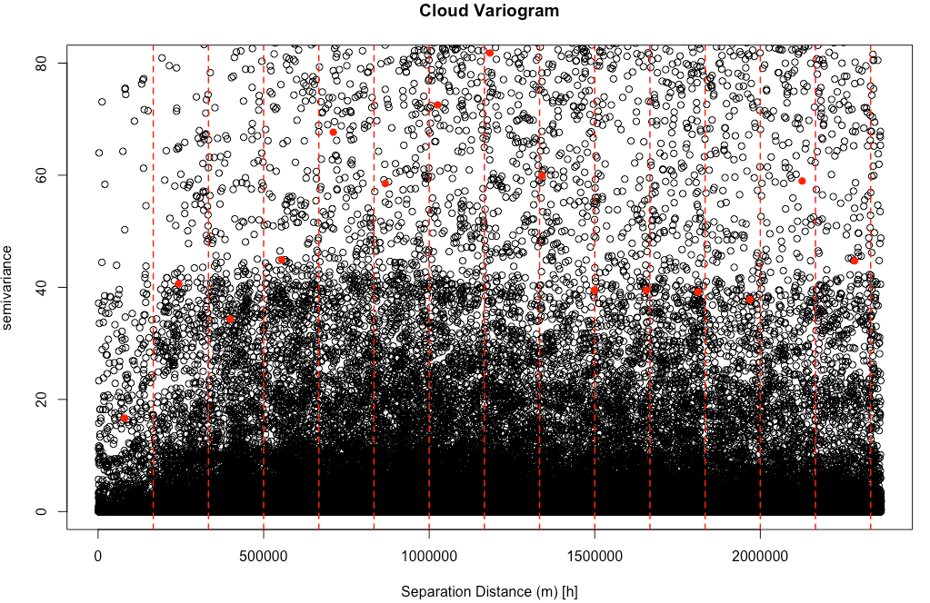
Step 1: Variogram analysis [2]
This plot is known as a Cloud Variogram, which contains a cloud of points.
We create bins (red dashed lines) and compute an average using all points within a bin. For example, all these points within the first bin (0m to 166666.7m) (i.e., rectangle block) are averaged to produce the red dot.
30

Slide 31
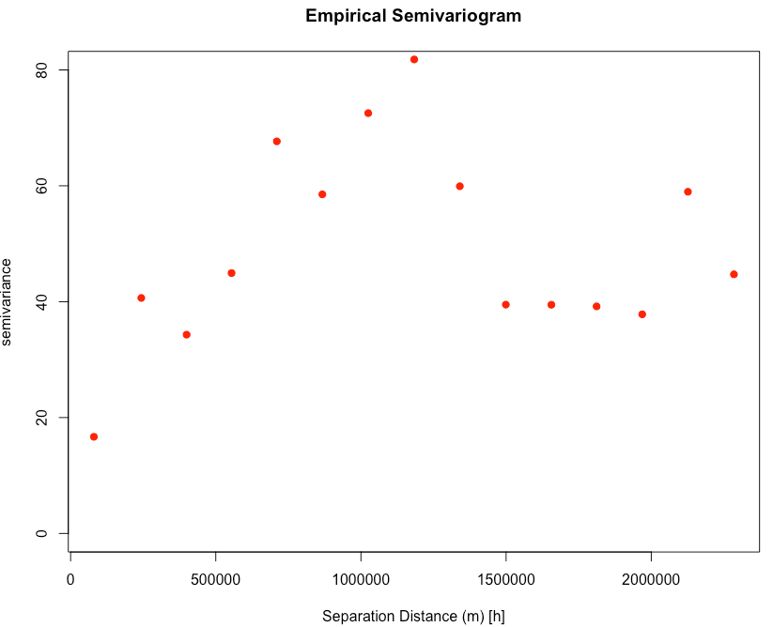
Step 1: Variogram analysis [3]
From the output, we should note the approximate values for the partial sill, nugget and range.
The nugget is roughly 17
The range is roughly 1180000 meters
The partial sill is 65. This is derived from the peak value for semivariance subtracted by the nugget (82 - 17 = 65).
These serve as initial values to give us an idea of what to expect when we proceed to fit a theoretical semivariogram
Here, we are eyeball here!
65
17
These help us generate some function, which in turn, helps us to determine whether this pattern is either Exponential, Spherical or Gaussian.
We need to select a function that’s appropriate for our Kriging model.
1180000m
31
Notes:
This is our empirical semivariogram. That’s one part of our step completed. Just eyeballing the output – we need to extract the following values for the nugget, range and partial sill to inform our fitted theoretical semivariogram. This part is simply an eyeballing exercise for the purposes of getting our initial values to fit for our theoretical variogram which would converge to the correct nugget, range and sill values.
This helps determine the appropriate function for the Kriging model.

Slide 32
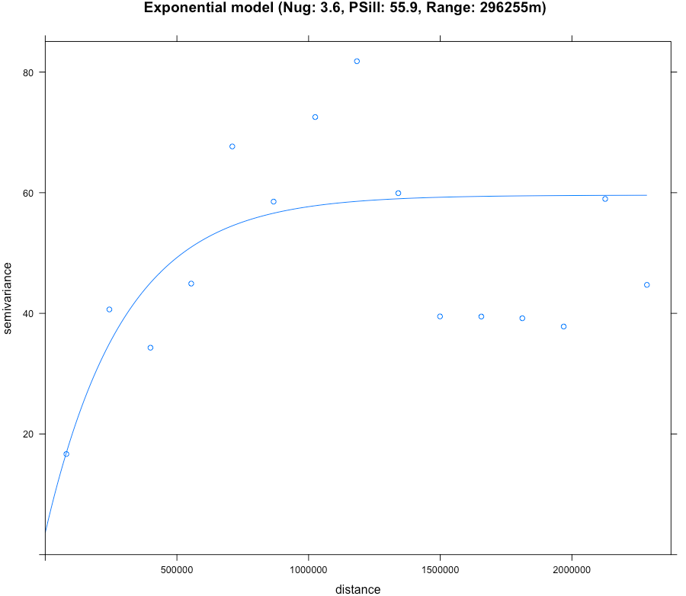



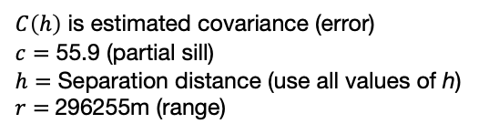
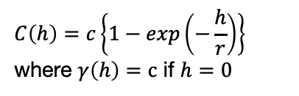
Step 2: Fitting the theoretical variogram
Difficult step is the determination for the appropriate theoretical variogram. It is basically up to the user in terms of which function is used…
An informed approach is allowing the software to make the selection for you:
Provide a set of initial values and modelled result from the Empirical Semivariogram. What happens is that the software will converge to the optimal nugget, Partial sill and range value
Based on the optimal values from point [1] and shape of the empirical variogram, and the best model is selected (in RStudio, we specify all 3 models as part of the model selection process).
Points are $γ\left(h\right)$ (empirical)
Fitted curve are $\overset{⃛}{ γ}\left(h\right)$ (theoretical)
Exponential:
Parameters:
$$C\left(h\right)=c\left\{1−exp\left(−\frac{h}{r}\right)\right\}$$
where $γ\left(h\right)=c$ if $h=0$
$C\left(h\right)$ is estimated covariance (error)
$c=$ 55.9 (partial sill)
$h=$ Separation distance (use all values of h)
$r=$296255m (range)
Fitted Semivariance:$\overset{⃛}{ γ}\left(h\right)=c −C\left(h\right)$
32
Notes:
Based on the initial values, it will converge to these values for nugget, partial sill and range… ,where the pattern follows an exponential model as the theoretical semivariogram.
These are the values we will than use to compute our covariance matrix from this exponential model

Slide 33


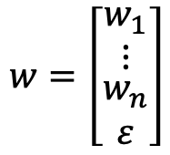


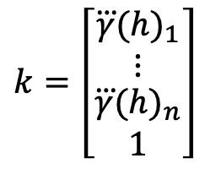
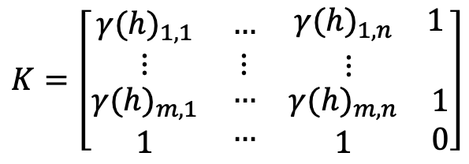

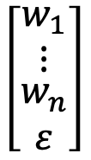
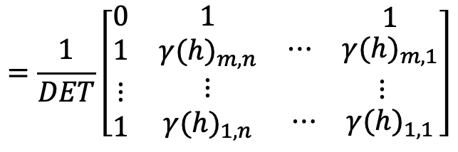


Step 3: Estimation of spatial weights
Our statistical model is:
$$x^{∗}=w_{1}x_{1}+w_{2}x_{2}+w_{3}x_{3}+…+w_{n}x_{n}+ ε$$
(m+1) by (n+1) K matrix
(m = n making it a square matrix )
$$K=\left[\begin{matrix}{γ(h)}_{1,1} & … & \begin{matrix}{γ(h)}_{1,n} & 1\end{matrix} \\ ⋮ & ⋮ & \begin{matrix}⋮ & \end{matrix} \\ \begin{matrix}{γ(h)}_{m,1} \\ 1\end{matrix} & \begin{matrix}… \\ …\end{matrix} & \begin{matrix}\begin{matrix}{γ(h)}_{m,n} \\ 1\end{matrix} & \begin{matrix}1 \\ 0\end{matrix}\end{matrix}\end{matrix}\right]$$
$$k=\left[\begin{matrix}\overset{⃛}{γ}{(h)}_{1} \\ \begin{matrix}⋮ \\ \begin{matrix}\overset{⃛}{γ}{(h)}_{n} \\ 1\end{matrix}\end{matrix}\end{matrix}\right]$$
$$w=\left[\begin{matrix}w_{1} \\ \begin{matrix}⋮ \\ \begin{matrix}w_{n} \\ ε\end{matrix}\end{matrix}\end{matrix}\right]$$
$$⋮$$
K, Semivariance computed from our empirical variogram
k, These are the corresponding Fitted semivariance computed from our theoretical variogram. The correspond to each other based on the separation distance h
w, these are the weight coefficients, along with the error we need to estimate.
To estimate w:
$$⋮$$
$$\left[\begin{matrix}w_{1} \\ \begin{matrix}⋮ \\ \begin{matrix}w_{n} \\ ε\end{matrix}\end{matrix}\end{matrix}\right]$$
$$=\frac{1}{DET}\left[\begin{matrix}0 & 1 & \begin{matrix}⋯ & 1\end{matrix} \\ 1 & {γ(h)}_{m,n} & \begin{matrix}⋯ & {γ(h)}_{m,1}\end{matrix} \\ \begin{matrix}⋮ \\ 1\end{matrix} & \begin{matrix}⋮ \\ {γ(h)}_{1,n}\end{matrix} & \begin{matrix}\begin{matrix}⋮ & ⋮\end{matrix} \\ \begin{matrix}⋯ & {γ(h)}_{1,1}\end{matrix}\end{matrix}\end{matrix}\right]$$
$$\left[\begin{matrix}\overset{⃛}{γ}{(h)}_{1} \\ \begin{matrix}⋮ \\ \begin{matrix}\overset{⃛}{γ}{(h)}_{n} \\ 1\end{matrix}\end{matrix}\end{matrix}\right]$$
$$w= K^{−1}k$$
$$≡$$
$$⋮$$
$$×$$
33
Notes:
Once all that is done, we can now estimate our weights and make predictions at blank locations. Remember our red dot?
This is derived by Lagrange approximation method.

Slide 34
Workflow for Kriging Modelling
34

Slide 35
Workflow for using a Kriging in R
When you want to conduct predictive inference with a geostatistical model – you might want to follow these steps:
STEP 1: Carry some descriptive analysis to understand the underlying spatial distribution. Make sure the underlying spatial process is from a continuous distribution (e.g., concentrations of air particulates, climate-related variables like rainfall, temperature etc., land surface elevation.
STEP 2: Standardisation of spatial data to a single CRS. If the data is in decimal degrees (aka WGS84: 4326) – I highly recommend to transform them to a distance that’s understandable (i.e., meters, kilometres etc.,); Use either Spherical Mercator (EPSG: 3587) (or if dealing with UK data – British National Grid [EPSG: 27700])
STEP 3: Construction an empirical semivariogram, to estimate the values for nugget, sill and range. Next, use the initial values to determine the best fitted “Theoretical Semivariance”; here, we will use the best fitted models’ nugget, sill and range to set the Kriging model.
STEP 4: Setting up the raster template for Kriging. Again, make sure that the raster’s CRS matches that of the point data and shapefile.
STEP 5: Apply Kriging on to the raster template – to outputs of interest: [1] Prediction and [2] Levels of uncertainty (error)
35

Slide 36

Output 1: Predicted air SO₂ level from the Kriging model
36

Slide 37

Output 2: Uncertainty for the predicted air SO₂ levels
from the Kriging model
37

Slide 38



Summary [2]: Best practice for visualisation and interpretation
Variogram analysis
Predicted air SO₂ level from the
Kriging model
Uncertainty for the predicted air SO₂
levels from the Kriging model
Interpretation: The nugget is a small value of 3.6, which is an indication for evidence of spatial variability in the concentrations for SO₂ across sampling sites in USA. The range is 296,255m, which indicates that any separation distance above this value means that spatial autocorrelation in the observed levels of SO₂ between points are no longer similar. However, points with a separation distance less than 296,255m indicated that their SO₂ values are similar. For the partial sill, within this range for the Semivariance i.e., 3.6 and 55.9 – is the values are spatially autocorrelated.
Along the belt of the following states – Missouri, Tennessee, Kentucky and Illinois, the predicted concentration of SO₂ levels exceeds +40ppb, whereas there are pockets in Texas where concentrations of SO₂ are a cause for concern i.e., 30-39.9ppb.
38

Slide 39
GEOG0114: Course Evaluation & Student Feedback (Week 4-6)
https://forms.gle/xvHPEnpARGTskXde7
Dear Students,
As part of the Continuous Module Dialogue, we are conducting this survey to gauge the levels of student satisfaction with the learning experience in module GEOG0114: Principles of Spatial Analysis. We would like to receive your feedback, which would be greatly appreciated. This will help us make improvements to the course. The survey should only take up to 5 or 10 minutes, and your responses are completely anonymous.
Thank you,
Anwar and Justin.
39

Slide 40
Any questions?
Important information
Not important information, but you should have some awareness though
40

